Slide 1
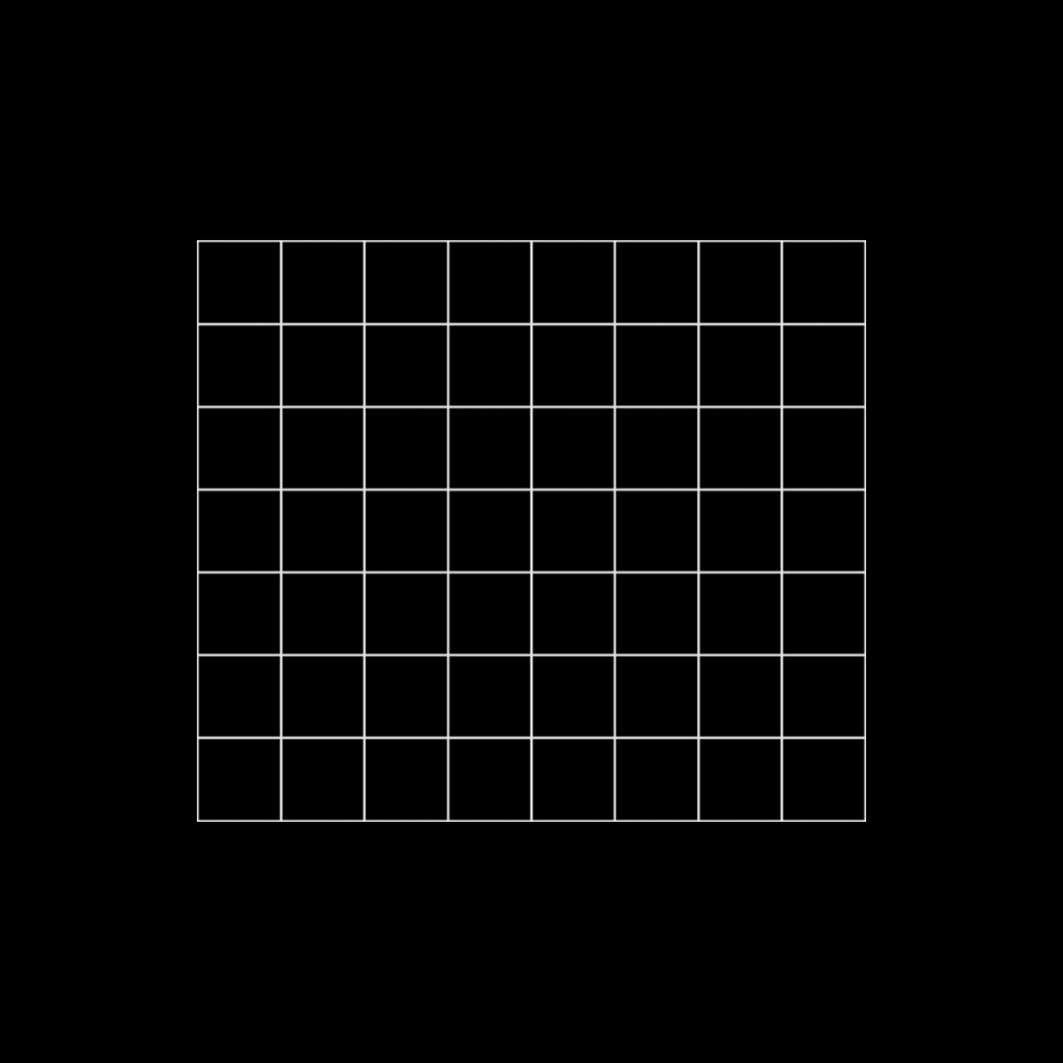
FP Growth
Ravan Iskandarov
Haji Akhundzada
Arzuman Hasanov

Slide 2
Introduction to the Algorithm:
The FP-Growth (Frequent Pattern Growth) algorithm, introduced by Han, Pei, and Yin in 2000, efficiently discovers frequent item sets in transactional data. By using an FP-tree data structure, it avoids generating candidate sets, making it faster than traditional methods like Apriori. Its significance lies in swiftly identifying frequent patterns in large datasets, crucial in various fields such as market basket analysis, recommendation systems, and bioinformatics, due to its reduced computational complexity and scalability, enabling valuable insights from vast transactional data.
2

Slide 3
Theoretical Foundations/Framework:
The FP-Growth algorithm is based on two main principles:
Frequent Pattern Tree (FP-Tree):
The FP-Tree is FP-Growth's core data structure, simplifying the transaction database. Each node represents an item with a count, and items are ordered by support, enabling efficient frequent itemset identification.
Divide-and-Conquer Strategy:
FP-Growth uses a divide-and-conquer strategy to mine frequent itemsets, building an FP-Tree as it processes transactions. The tree structure eliminates the need for candidate sets, a departure from earlier algorithms like Apriori.
3

Slide 4
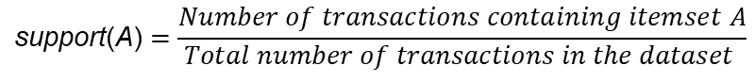
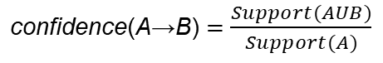
Mathematical Foundations:
a. Support Count: The support count of an itemset is the number of transactions that contain the itemset.
b. Support: The support of an itemset is defined as the ratio of its support count to the total number of transactions in the database. Mathematically, the support of an itemset A is given by:
$$\text{support}\text{(}\text{A}\text{)}=\frac{Number of transactions containing itemset A}{Total number of transactions in the dataset }$$
c. Confidence: Not directly used in FP-Growth, is a common measure in association rule mining, quantifying rule truth as:
$\text{confidence}\text{(}\text{A}\text{→}\text{B}\text{)}$ $=$ $\frac{Support(AUB)}{Support(A)}$
4

Slide 5
Algorithm Mechanics and Implementation:
Item | Frequency
A | 1
C | 2
D | 1
E | 4
I | 1
K | 5
M | 3
N | 2
O | 3
U | 1
Y | 3
dataset of transactions
Transaction ID | Items
T1 | {M, N, O, E, K, Y}
T2 | {D, O, E, N, Y, K}
T3 | {K, A, M, E}
T4 | {M, C, U, Y, K}
T5 | {C, O, K, O, E, I}
Note: Minimum support is 3
Remain items: {K: 5, E: 4, M : 3, O : 3, Y : 3}
5

Slide 6
After removing infrequent items and re-ordering them in the descending order of their frequency, we get:
Transaction ID | Items | Ordered Itemset
T1 | {M, N, O, E, K, Y} | {K, E, M, O, Y}
T2 | {D, O, E, N, Y, K} | {K, E, O, Y}
T3 | {K, A, M, E} | {K, E, M}
T4 | {M, C, U, Y, K} | {K, M, Y}
T5 | {C, O, K, O, E, I} | {K, E, O}
6

Slide 7
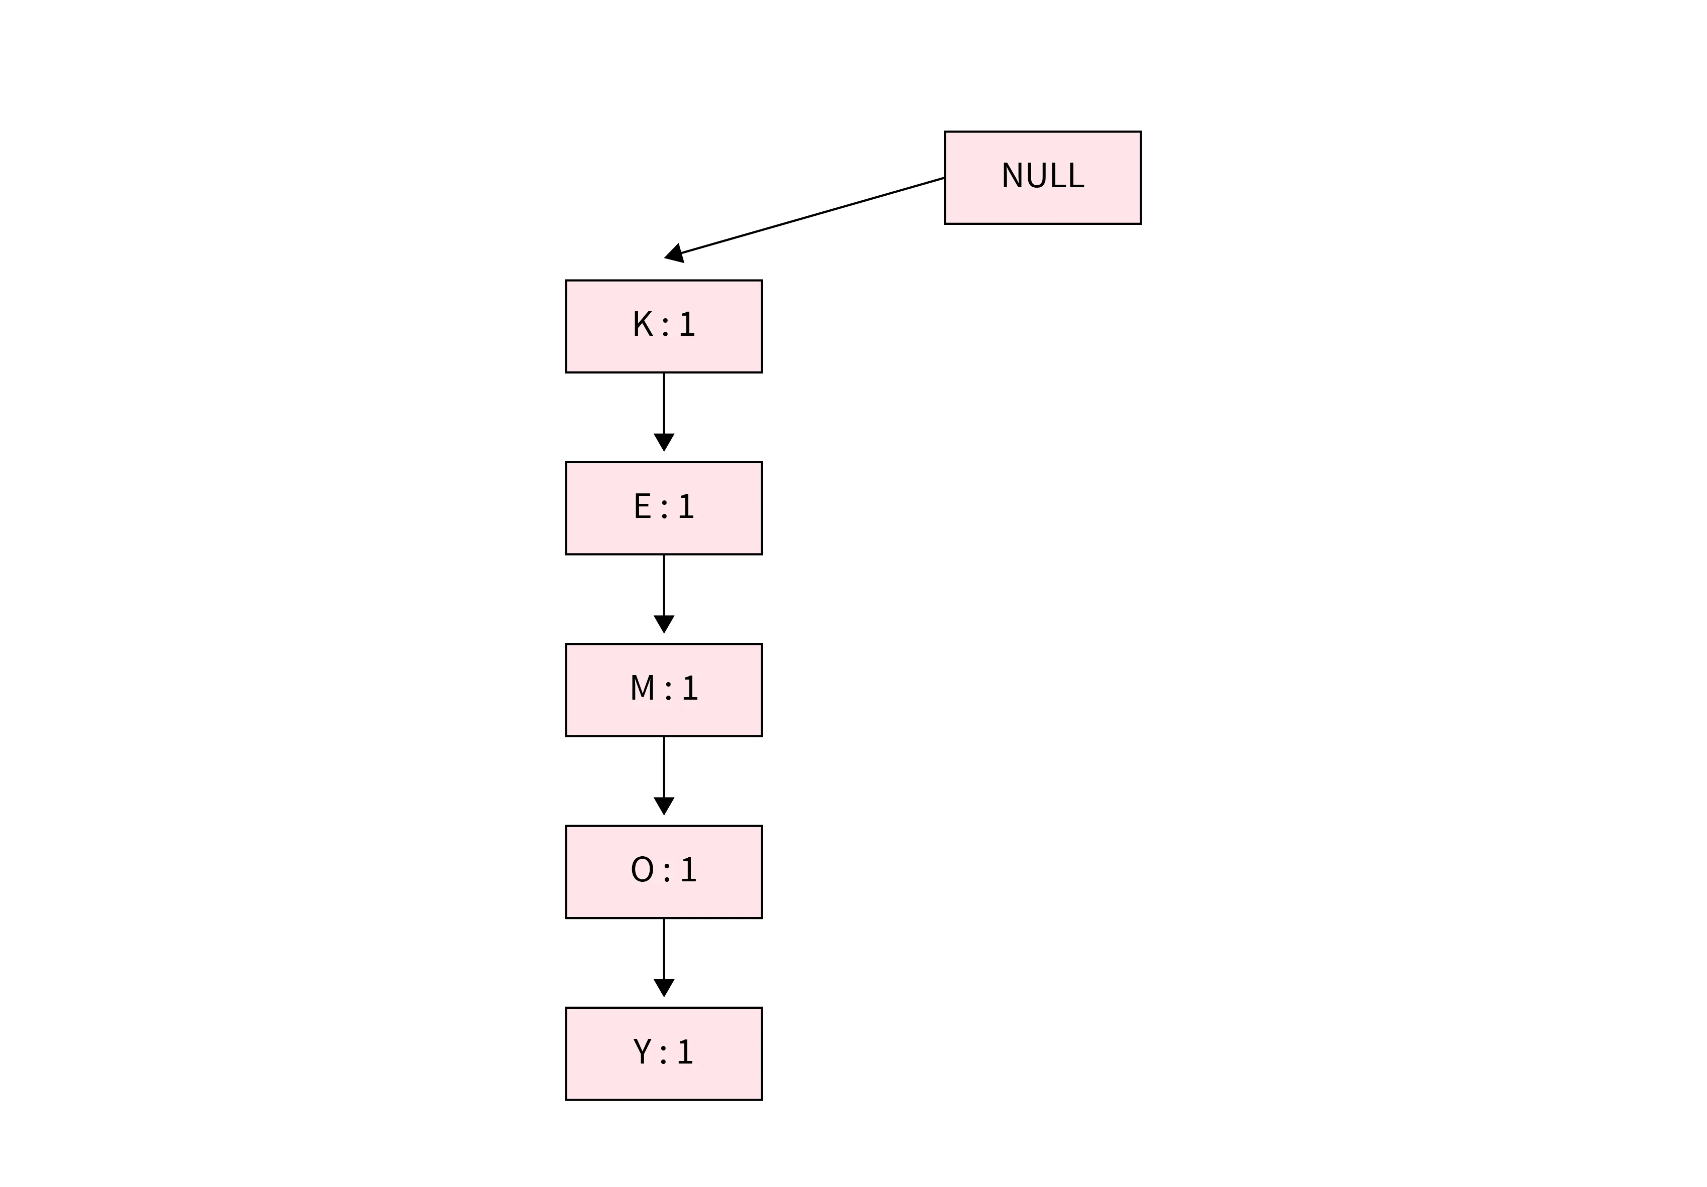
Transactions
1. {K, E, M, O, Y}:
7

Slide 8
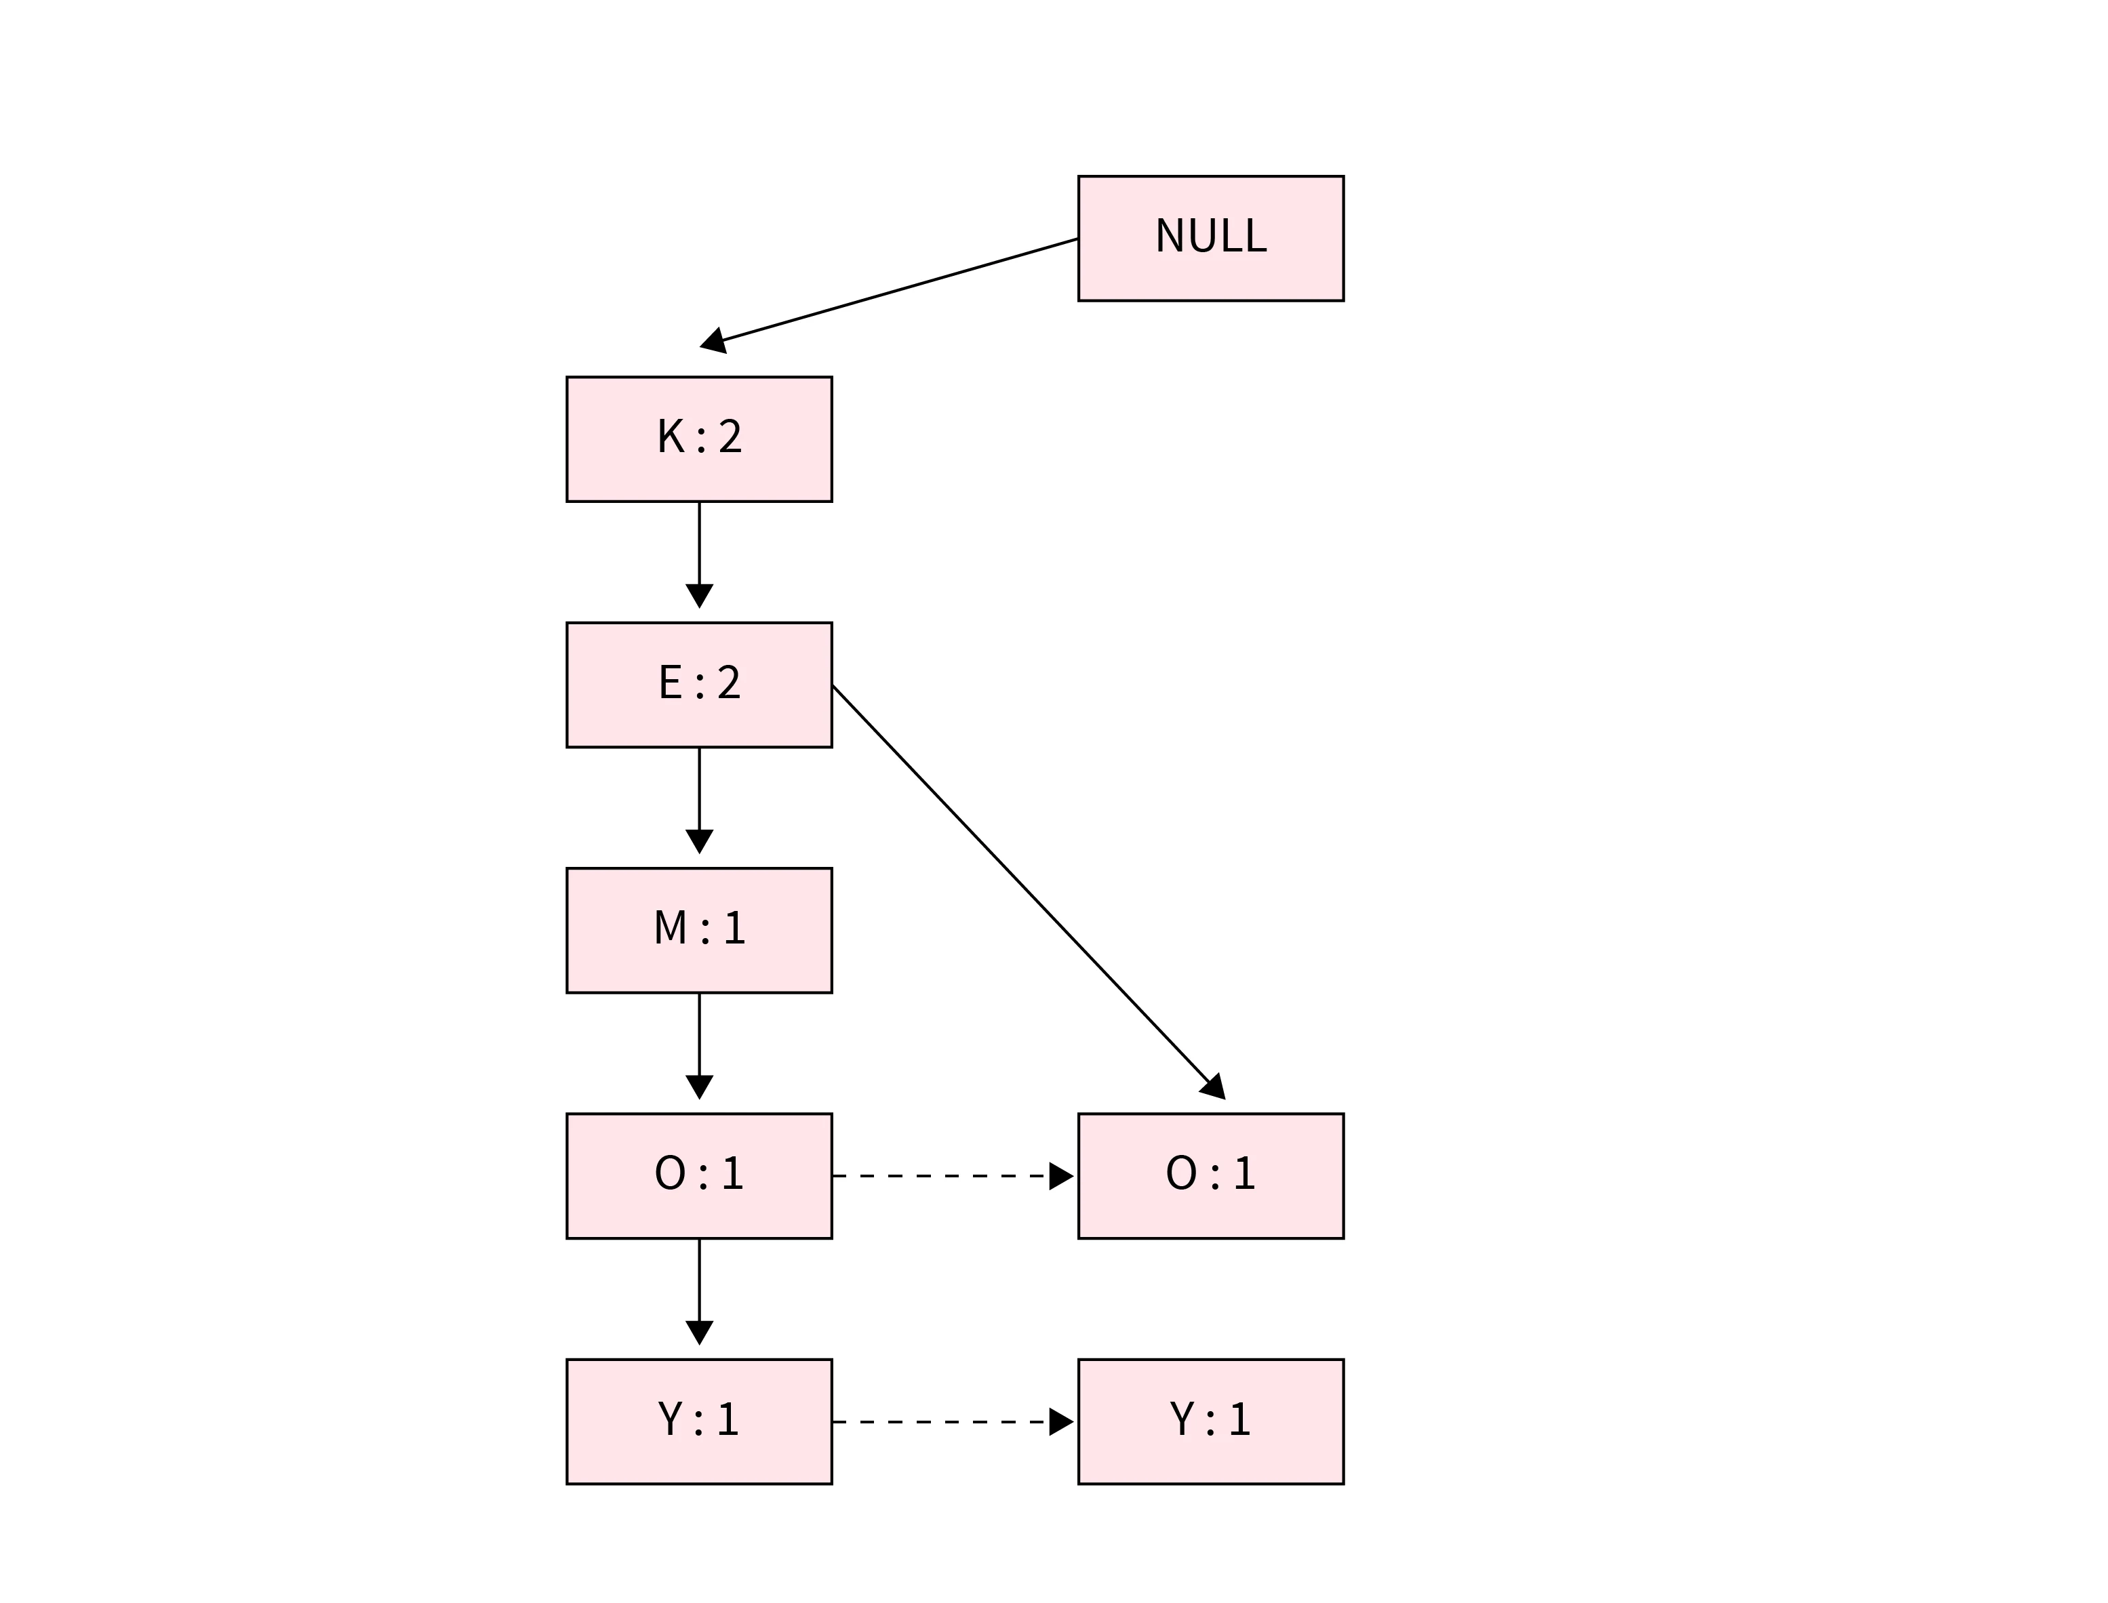
Transactions
1. {K, E, M, O, Y}:
2. {K, E, O, Y}:
8

Slide 9

Transactions
1. {K, E, M, O, Y}:
2. {K, E, O, Y}:
3. {K, E, M}:
9

Slide 10
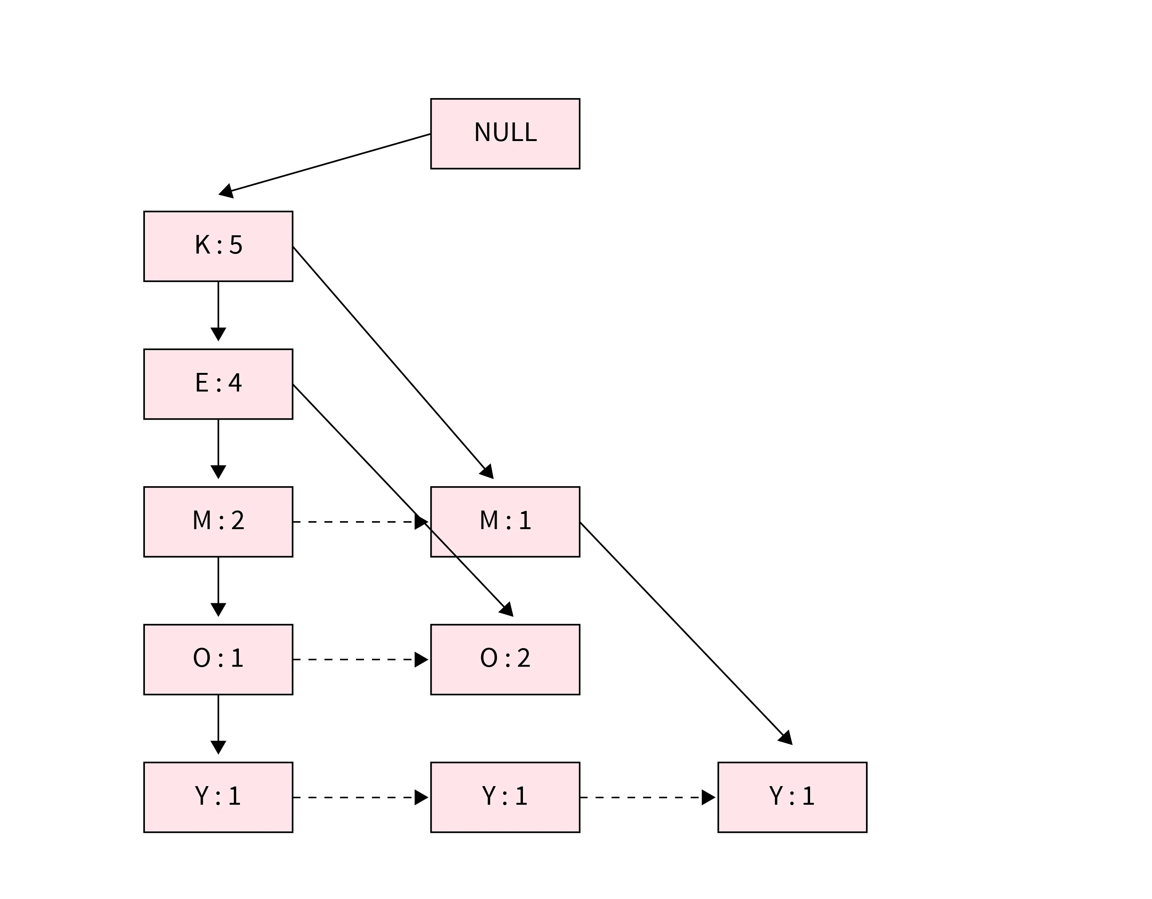
Transactions
1. {K, E, M, O, Y}:
2. {K, E, O, Y}:
3. {K, E, M}:
4. {K, M, Y}:
5. {K, E, O}:
10

Slide 11
Now we create a Conditional Pattern Base for all the items
Item | Conditional Pattern Base | Conditional FP Tree
Y | {K, E, M, O : 1}, {K, E, O : 1}, {K, M : 1} | {K : 3}
O | {K, E, M : 1}, {K, E : 2} | {K, E : 3}
M | {K, E : 2}, {K: 1} | {K : 3}
E | {K: 4} | {K: 4}
K
Item | Frequent Patterns
Y | {K, Y - 3}
O | {K, O - 3}, {E, O - 3}, {K, E, O - 3}
M | {K, M - 3}
E | {K, E - 4}
The conditional FP-Tree is constructed by finding the set of elements that appear in all paths of the conditional pattern base for a given frequent item and summing their support counts.
11

Slide 12
Real-world Applications
Frequent Pattern Growth (FP-growth) is a popular algorithm used in data mining and association rule learning. It's commonly applied in various real-world scenarios where discovering patterns in large datasets is essential. Here are some real-world applications of FP-growth:
Market Basket Analysis
Healthcare
Fraud Detection
Web Usage Mining
Telecommunications
Text Mining and Natural Language Processing (NLP)
Bioinformatics
Manufacturing and Supply Chain Management
Social Network Analysis
Recommender Systems
12

Slide 13
Real-world Application
One real-life problem that can be solved with the FP-Growth algorithm is market basket analysis. Market basket analysis is the process of analyzing customer purchase patterns to identify associations between products. This analysis can help businesses better understand customer behavior and make informed decisions about product placement, pricing, and promotions.
For example, consider a grocery store that wants to understand which products are frequently purchased together. The store can identify common patterns by analyzing transaction data and using this information to optimize product placement and promotions.
13

Slide 14
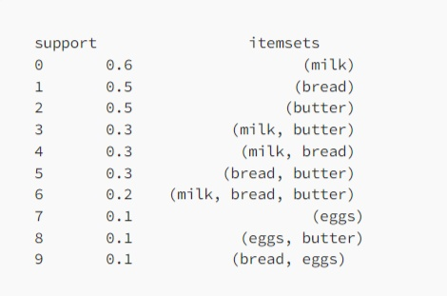
Market Basket Analysis
Result of Analysis
This analysis shows that milk, bread, and butter are the products that are purchased most frequently, with support of 0.6, 0.5, and 0.5, respectively. We can also see that customers who buy milk are likely to buy butter, and customers who buy bread are likely to buy butter. With this information, the grocery store can optimize product placement by placing milk, bread, and butter near each other and offering promotions or discounts for customers who purchase these items together.
14

Slide 15
The code is available at the following URL.
GOOGLE COLAB
15

Slide 16
Strengths and Limitations
Advantages
Efficiency: The algorithm is very efficient and can handle large datasets with many transactions and items.
Scalability: It is scalable and can handle datasets with millions of transactions.
Memory efficiency: The algorithm uses a compact data structure called a frequent pattern tree (FP-tree), which is memory-efficient and reduces the need for multiple scans of the transaction database.
Flexibility: The algorithm can be applied to different data types, such as categorical or numerical data.
Fast performance: The algorithm can quickly generate frequent item sets and association rules.
16

Slide 17
Disadvantages
It requires a lot of preprocessing: The algorithm requires significant preprocessing to build the FP-tree data structure before mining frequent item sets and association rules.
Limited to categorical data: The algorithm is best suited for categorical data, such as products purchased in a store. It may not be effective for continuous or mixed data.
It may generate many item sets: The algorithm may generate frequent item sets, making interpreting and applying the results challenging.
It requires domain knowledge: The algorithm requires domain knowledge to interpret and apply the results effectively.
It may not work well with sparse data: The algorithm may not work well with datasets with many missing values or sparse data, where transactions have only a few items.
17

Slide 18
Use Case/Example Scenario
Berkah Mart is a newly opened minimarket in Pekanbaru that utilizes traditional store management methods without analyzing sales data or considering consumer perspectives. To improve product placement and availability planning, this research proposes the use of the FP-Growth algorithm for Market Basket Analysis. The algorithm helps to identify consumer spending patterns, allowing Berkah Mart to effectively tailor promotions to specific customer groups. The results show that the FP-Growth algorithm efficiently analyzes consumer shopping patterns, leading to a significant increase in Berkah Mart's revenue.
Market Basket Analysis Using Apriori and FP-Growth for Analysis
Consumer Expenditure Patterns at Berkah Mart in Pekanbaru Riau
Product recommendation system on building materials shopping using FP-Growth algorithm
18

Slide 19
Conclusion and Discussion:
To sum up, the FP-Growth algorithm stands out for efficiently uncovering patterns in vast datasets across diverse industries. Despite its efficiency and scalability benefits, it requires preprocessing and is most effective with categorical data. This session highlighted its significance and real-world applications. We now welcome your questions and thoughts for an engaging discussion.
19

Slide 20
References
Youtube video: https://youtu.be/7oGz4PCp9jI?si=IB8Y3uPAr6vQOfNe
Geeksforgeeks: https://www.geeksforgeeks.org/frequent-pattern-growth-algorithm/
Book: http://myweb.sabanciuniv.edu/rdehkharghani/files/2016/02/The-Morgan-Kaufmann-Series-in-Data-Management-Systems-Jiawei-Han-Micheline-Kamber-Jian-Pei-Data-Mining.-Concepts-and-Techniques-3rd-Edition-Morgan-Kaufmann-2011.pdf
20

Slide 21
Thanks!

